Slide 1
COMP 3500 Introduction to Operating Systems Synchronization: Part 2 Mutual Exclusion
Dr. Xiao Qin
Auburn University http://www.eng.auburn.edu/~xqin
xqin@auburn.edu
Notes:
5 Minutes Lec03a-Process Part 2: slides 16-20
40 Minutes Slides: 16
To present the concept of process synchronization.
To introduce the critical-section problem, whose solutions can be used to ensure the consistency of shared data
To present both software and hardware solutions of the critical-section problem
To examine several classical process-synchronization problems
To explore several tools that are used to solve process synchronization problems

Slide 2
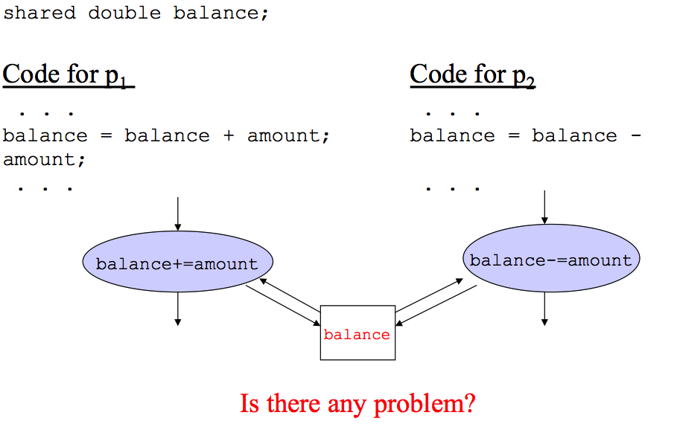
Recap: Critical Sections
Notes:
At first glance, it may seem that interleaving and overlapping represent fundamentally different modes of execution and present different problems. In fact, both techniques can be viewed as examples of concurrent processing, and both present the same problems. In the case of a uniprocessor, the problems stem from a basic characteristic of multiprogramming systems: The relative speed of execution of processes cannot be predicted. It depends on the activities of other processes, the way in which the OS handles interrupts, and the scheduling policies of the OS.

Slide 3
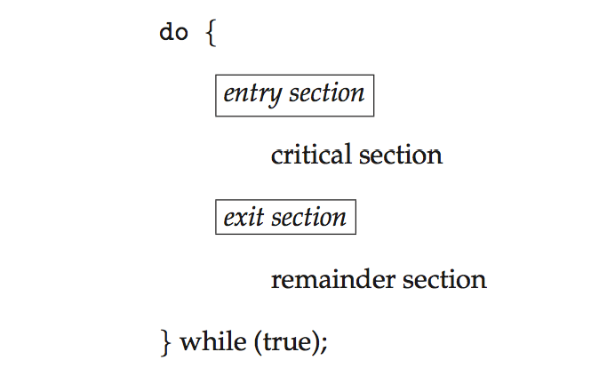
Recap: General structure of process P_{i}
Notes:
Consider system of n processes {p₀, p₁, … p_{n-1}}
Each process has critical section segment of code
Process may be changing common variables, updating table, writing file, etc
When one process in critical section, no other may be in its critical section
Each process must ask permission to enter critical section in entry section, may follow critical section with exit section, then remainder section

Slide 4
Recap: Peterson’s Solution
do {
flag[i] = true;
turn = j;
while (flag[j] && turn = = j);
critical section
flag[i] = false;
remainder section
} while (true);
Notes:
Question: How to control turns?
It was formulated by Gary L. Peterson in 1981.
Reference: https://en.wikipedia.org/wiki/Peterson%27s_algorithm
Good algorithmic description of solving the problem
Two process solution
Assume that the load and store machine-language instructions are atomic; that is, cannot be interrupted
The two processes share two variables:
int turn;
Boolean flag[2]
The variable turn indicates whose turn it is to enter the critical section
The flag array is used to indicate if a process is ready to enter the critical section. flag[i] = true implies that process P_{i} is ready!
Assumption: the load and store instructions are atomic
The two processes share two variables:
int turn;
Boolean flag[2]
turn: whose turn it is to enter the critical section
flag: to indicate if a process is ready to enter the critical section. flag[i] = true implies that process P_{i} is ready!

Slide 5
Peterson’s Solution (Cont.)
Provable that the three CS requirement are met:
1. Mutual exclusion is preserved
P_{i} enters CS only if:
either flag[j] = false
or turn = i
2. Progress requirement is satisfied
3. Bounded-waiting requirement is met

Slide 6
Mutual Exclusion: Hardware Support
Q1: Any Problem?
Interrupt Disabling
uniprocessor system
disabling interrupts
guarantees mutual
exclusion
Disadvantages
the efficiency of
execution could be
noticeably degraded
this approach will not
work in a
multiprocessor
architecture
Notes:
Many systems provide hardware support for implementing the critical section code.
All solutions below based on idea of locking
Protecting critical regions via locks
Uniprocessors – Disable interrupts
Running code cannot be preempted
Generally too inefficient on multiprocessor systems
Special atomic hardware instructions
Atomic = non-interruptible
Either test memory word and set value
Or swap contents of two memory words
In a uniprocessor system, concurrent processes cannot have overlapped execution;
they can only be interleaved. Furthermore, a process will continue to run until it
invokes an OS service or until it is interrupted. Therefore, to guarantee mutual exclusion,
it is sufficient to prevent a process from being interrupted. This capability
can be provided in the form of primitives defined by the OS kernel for disabling and
enabling interrupts.
Because the critical section cannot be interrupted, mutual exclusion is guaranteed.
The price of this approach, however, is high. The efficiency of execution could
be noticeably degraded because the processor is limited in its ability to interleave
processes. Another problem is that this approach will not work in a multiprocessor
architecture. When the computer includes more than one processor, it is possible (and
typical) for more than one process to be executing at a time. In this case, disabled
interrupts do not guarantee mutual exclusion.

Slide 7
Solution to Critical-section Problem Using Locks
do {
acquire lock
critical section
release lock
remainder section
} while (TRUE);

Slide 8
The test_and_set Instruction
Q2: What does this function do?
boolean test_and_set (boolean *target)
{
boolean rv = *target;
*target = TRUE;
return rv;
}
Executed atomically
Returns the original value of passed parameter
Set the new value of passed parameter to “TRUE”.
Notes:
Tips:
Consider target as a lock
Think about two cases: (1) lock is true (locked) (2) lock is false (unlocked)

Slide 9
How to use test_and_set()?
Shared Boolean variable lock, initialized to FALSE
do { while (test_and_set(&lock))
; /* do nothing */
/* critical section */
lock = false;
/* remainder section */
} while (true);
TRUE means it is locked!
Who locks this section?
Unlocked it!

Slide 10
The compare_and_swap Instruction
Q3: What does this function do?
int compare_and_swap(int *value, int expected, int new_value) {
int temp = *value;
if (*value == expected)
*value = new_value;
return temp;
}
Executed atomically
Returns the original value of passed parameter “value”
Set the variable “value” the value of the passed parameter “new_value” but only if “value” ==“expected”. That is, the swap takes place only under this condition.
Notes:
Similar to test_and_set

Slide 11
How to use compare_and_swap?
Shared integer “lock” initialized to 0;
do { while (compare_and_swap(&lock, 0, 1) != 0 )
; /* do nothing */
/* critical section */
lock = 0;
/* remainder section */
} while (true);
It is locked!
Who locks this section?
Unlocked it!
Q4: Is there any problem?
Notes:
Answer: Bounded-waiting Problem

Slide 12
Bounded-waiting Mutual Exclusion
do { waiting[i] = true; key = true; while (waiting[i] && key)
key = test_and_set(&lock);
waiting[i] = false;
/* critical section */
j = (i + 1) % n;
while ((j != i) && !waiting[j])
j = (j + 1) % n;
if (j == i)
lock = false;
else
waiting[j] = false;
/* remainder section */
} while (true);
i is waiting now
i waits and locked
Unlocked but what?
i is not waiting
Nobody is waiting
Find the next waiting process
Let j enter. How?
Notes:
Unlocked but what? It’s not your turn yet.

Slide 13
Summary
The test_and_set Instruction
The compare_and_swap Instruction
Bounded-waiting Mutual Exclusion

